Slide 1
The Mission Mind of a Special Pastor
Brotherhood & WMU
Monday, January 29, 2018

Slide 2
BROTHER DON’S STATEMENT:
“Something ‘S T I R R I N G’ to bring the people together to do a work.”

Slide 3
Georgia Baptist Men’s Ministry
Dedicated to assisting churches and associations in developing Kingdom-minded men to be Godly leaders in the home, the church and their communities.
Seeks to involve men and boys in missions through education and personal involvement so that everybody, everywhere will have an opportunity to KNOW Jesus.

Slide 4
W M U AND WOMEN’S MINISTRY
Our mission is to encourage, equip, and engage women and girls to discover and live out their purpose in God’s Kingdom.
Vision Statement: Because we believe God is Who He says He is and can do what He says He will do, we are empowered to engage a lost world through prayer, ministry and witness that will be modeled, taught and nurtured among future generations. “And without faith, it is impossible to please God” (Hebrews 11:6a).

Slide 5
Appalachee Baptist Association
Brother Don is currently Clerk of the
Appalachee Baptist Association

Slide 6
BACK PACKS OF HOPE
Pictured with the group who delivered Back Packs from Year 2015 are Evelyn Cureton
Barbara Roberts
Jerry Thompson

Slide 7
LOTTIE MOON “HANG an ANGEL”
Brother Don supports the Lottie Moon Christmas Offering as he “hangs an angel” on the tree. ***Leading by Example”

Slide 8
Literacy Missions Workshop
Brother Don receives his certificate of completion for the 12 Hour Workshop

Slide 9
Literacy Missions Adult Reading and Writing Workshop at Ebenezer
Brother Don and Betty Jean Johnston practice how to help an adult either learn to read and write or to improve their reading skills.
Then the Lord answered me and said, “Write the vision and make it plain on tablets, that he may RUN who READS it.” Habakkuk 2:2

Slide 10
BRIDGE EVENTS
Bridges make travel easier. God has placed the Church in the world to build bridges between people and Himself, making it easier for the unsaved to move toward a personal relationship with Christ. A bridge is an intentional direct encounter by an individual or church with a pre-Christian to become acquainted with him or her, understand needs, provide encouragement and assistance in the name of Jesus, and demonstrate the love and care of God.
***Among other bridges, Ebenezer provides Outreach Bible studies (VBS), Entertainment Bridges-art, music events- and Special Events Inspirational Bridges—Youth Programs, May Day, Fall Festival (Christmas and Easter Events)***

Slide 11
Major Bridge Events at Ebenezer
V B S FALL FESTIVAL
May Day
Youth Seasonal Performances
Easter and Christmas Musicals

Slide 12
V B S at EBENEZER

Slide 13
V B S Activities-- Bro. Don’s Adult Class

Slide 14
Teaching the VBS Adult Class

Slide 15
V B S
Agency D-3 Secret Agent VBS
2013

Slide 16
V B S Fun at Ebenezer “For the love of Christ compels us…II Cor. 5:14

Slide 17
MAY DAY
May Day
Pig Pickin’
at EBC

Slide 18
MAY DAY and PIG PICKIN’

Slide 19
May Day for all Ages

Slide 20
FALL FESTIVAL
STIRRING THE STEW
SERVING AT THE MEAL

Slide 21
YOUTH ACTIVITIES

Slide 22
CHILDREN CHRISTMAS

Slide 23
CHRISTMAS MUSICAL
Brother Don speaks to the congregation after the presentation

Slide 24
ADULT CHOIR

Slide 25
Let the Children Come……
Jesus Loves me this I know!

Slide 26
More Children

Slide 27
Baptizing the Children

Slide 28
More Baptisms

Slide 29
Bro. Don Supports the Prayer Group First Met on Sunday, May 12, 1991

Slide 30
WMU and BROTHERHOOD
Bro. Don takes an active role……

Slide 31
CHURCH FAMILY FUN EVENTS
II Cor. 5:11-15
Our Love for God energizes us to do what we do for God!

Slide 32
Easter Egg Hunt
And then
Back to the Church for the Resurrection Story!

Slide 33
The Resurrection Story with Pam Peters

Slide 34
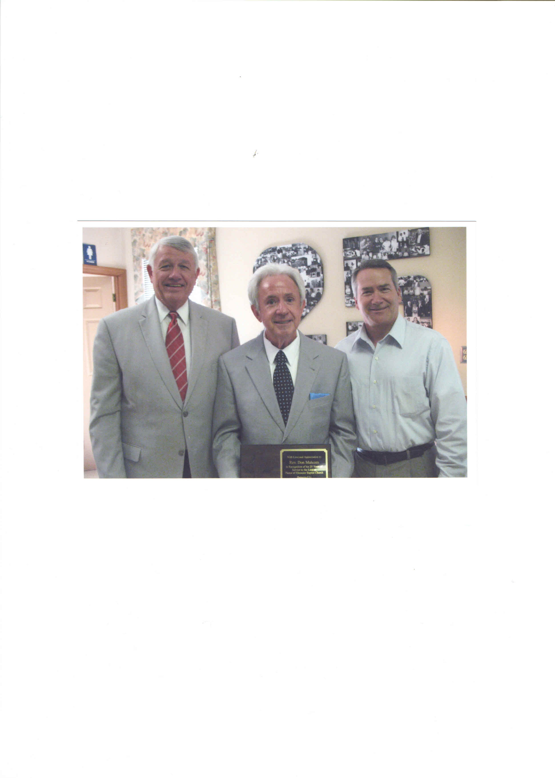
On Mission 26+ years Col. 3:23-24 And whatsoever you do, do it heartily, as to the Lord and not to men, knowing that from the Lord you will receive the reward of the inheritance, for you serve the Lord Christ!

Slide 35
I John 3:18 “We must not love with word or speech, but with the truth and action.”
GOD IS SO GOOD!

